Slide 1

Flight Delay Analysis Prediction
By
Thrushwanth Kakuturu - KO67574

Slide 2
Problem Statement and Description
The aviation industry is crucial for connecting businesses and people across the globe, but flight delays caused by extreme weather conditions and other factors pose a significant challenge for both airlines and passengers. According to a study by UC Berkeley academics, domestic flight delays cost the US economy $38.3 billion in 2019, with airline customers bearing about half of the cost. Therefore, accurate analysis of flight delays is essential to mitigate their negative impact on both passengers and airlines.
This project aims to perform analysis on flight delays caused by different factors, enabling airlines to take proactive measures to minimize delays and passengers to plan their journeys accordingly.

Slide 3
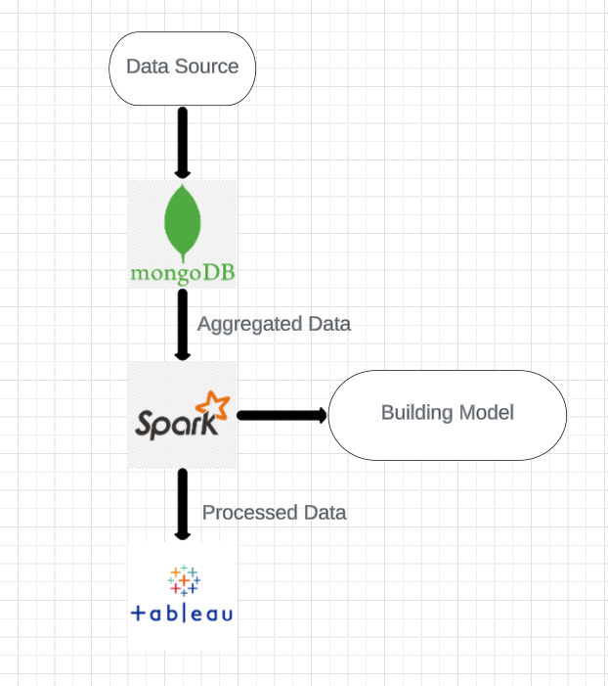
Tools Used and Actual Implementation
Mongodb
Jupyter Note book
Apache Spark
Tableau
Data is first stored in MongoDB, and then aggregated to prepare it for processing using Apache Spark.

Slide 4
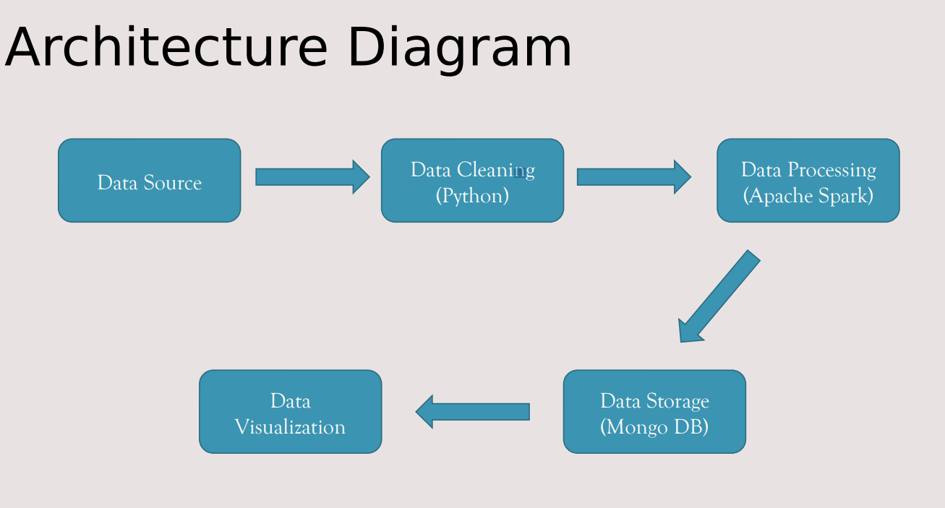
Implementation in Project Progress Report

Slide 5
Data set
We have downloaded the data from the Kaggle https://dataverse.harvard.edu/dataset.xhtml?persistentId=doi:10.7910/DVN/HG7NV7. We have used 12 years data from 1987 to 1998.
1987 has around 1.6 million rows, similarly total data is about 10gb with more than 65 million rows.
The data set has following columns describing various information about flights, which you can see in next slide.
This flights data, where flights are originated and terminated in united states.

Slide 6
Name​ | Description​
Year​ | 1987 - 2008​
Month​ | 1 - 12​
DayofMonth​ | 1 - 31​
DayOfWeek​ | 1 (Monday) - 7 (Sunday) ​
DepTime ​ | actual departure time(local, hhmm)​
CRSDepTime ​ | scheduled departure time (local, hhmm)​
ArrTime ​ | actual arrival time (local, hhmm)​
CRSArrTime ​ | scheduled arrival time (local, hhmm)​
UniqueCarrier ​ | unique carrier code​
FlightNum​ | flight number​
TailNum​ | plane tail number​
ActualElapsedTime​ | In minutes​
CRSElapsedTime​ | In minutes​
AirTime ​ | In minutes​
ArrDelay​ | arrival delay, in minutes ​
DepDelay ​ | departure delay, in minutes​
Origin ​ | origin IATA airport code​
Dest ​ | destination IATA airport code​
Distance​ | in miles​
TaxiIn​ | taxi in time in minutes​
TaxiOut ​ | taxi out time in minutes ​
Cancelled​ | was the flight cancelled?​
CancellationCode ​ | reason for cancellation (A = carrier, B = weather, C = NAS, D = security) ​
Diverted ​ | 1 = yes, 0 = no ​
CarrierDelay ​ | in minutes ​ ​
WeatherDelay ​ | in minutes ​
NASDelay ​ | in minutes​
SecurityDelay ​ LateAircraftDelay ​ ​ ​ | in minutes​

Slide 7

Data Storage and Aggregation
We have been using MongoDB Compass as our primary database management system for the past 12 years.
We created a database named "flight_delay_analysis" using MongoDB Compass and stored our data files in it.
Using the PyMongo library in Jupyter Notebook, we filtered the data by selecting 20 airports. This allowed us to focus on the specific data points that we needed for our analysis.
After filtering the data, we aggregated it using MongoDB's built-in aggregation framework. This allowed us to group the data by specific criteria and summarize the results in a meaningful way.

Slide 8
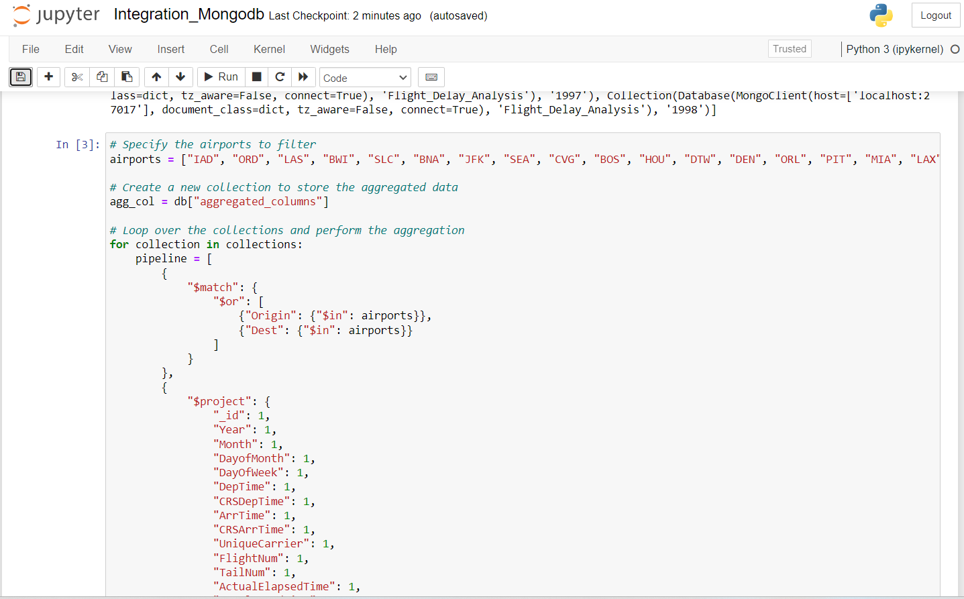
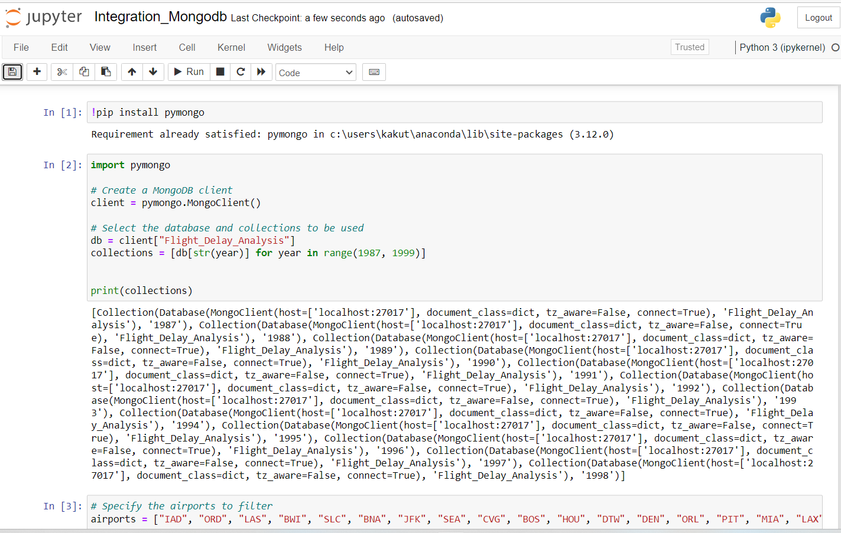
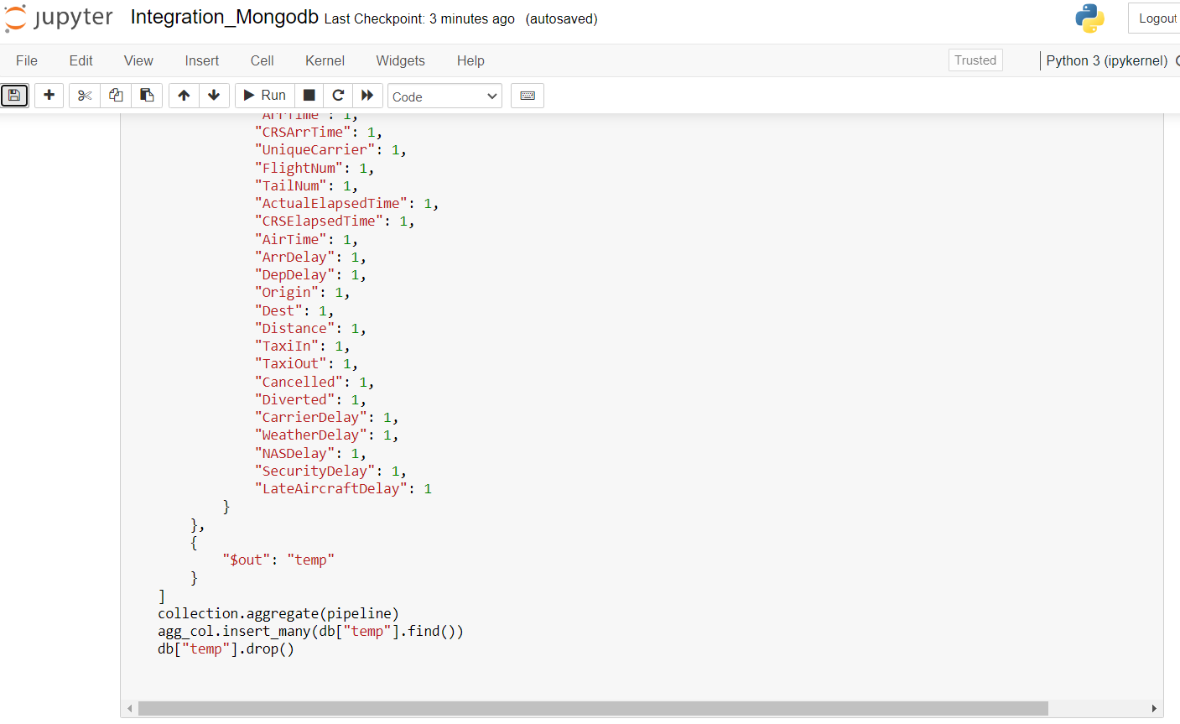

Slide 9
Data Storage and Aggregation
We created a new collection named "aggregated_columns" to store the aggregated data. This collection was added to the existing "flight_delay_analysis" database.
The aggregated data contained 33.2 million rows, which is a significant amount of data to work with.
To preprocess the data for further analysis, we used mongodb spark integrater to get the data and run Apache Spark to perform advanced analytics on the data.

Slide 10
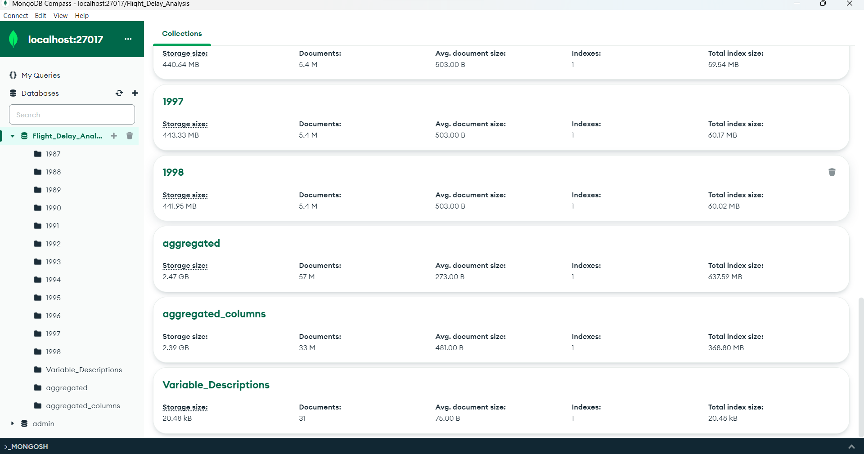

Slide 11
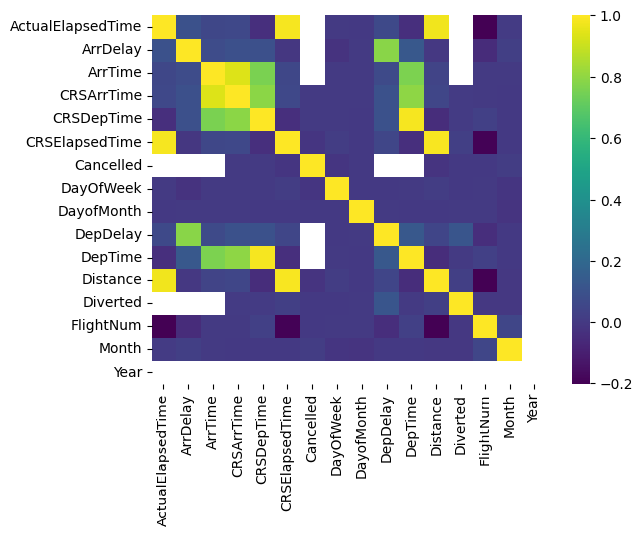
Data Processing
The aggregated_columns data set is used to perform explorative data analysis in colab using pyspark library by creating spark session.
The processed data is used to get the visualizations from the Tableau

Slide 12
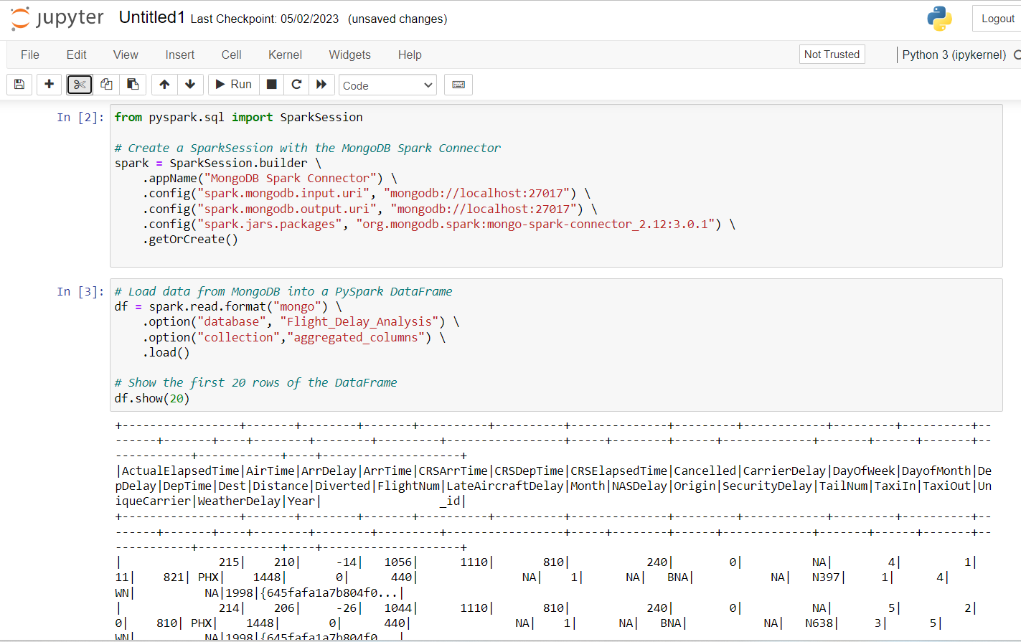
Spark Mongodb Integration

Slide 13
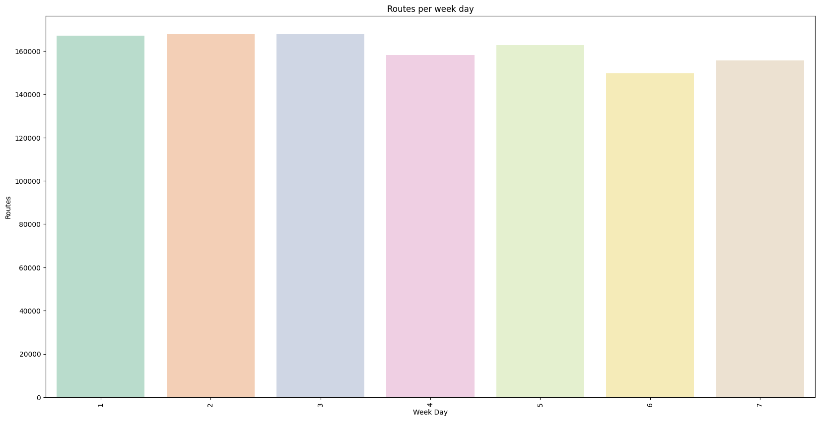
Charts With Historical Data

Slide 14
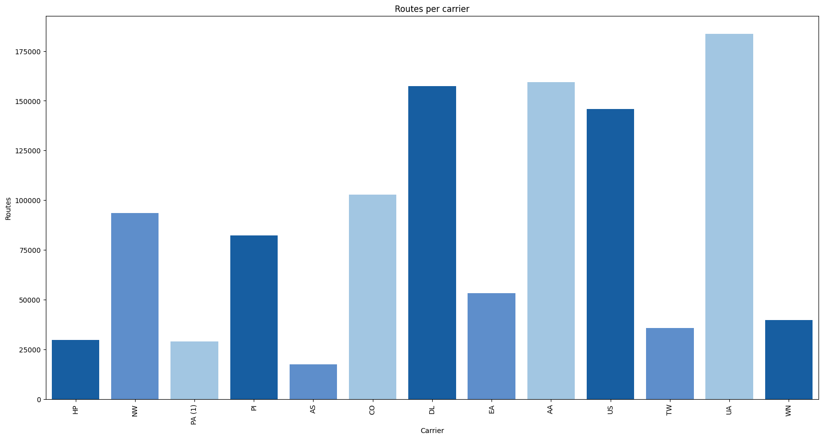

Slide 15
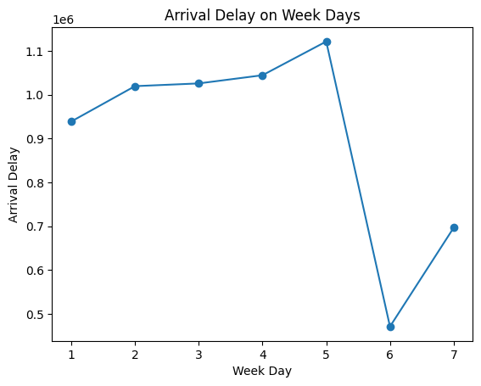

Slide 16
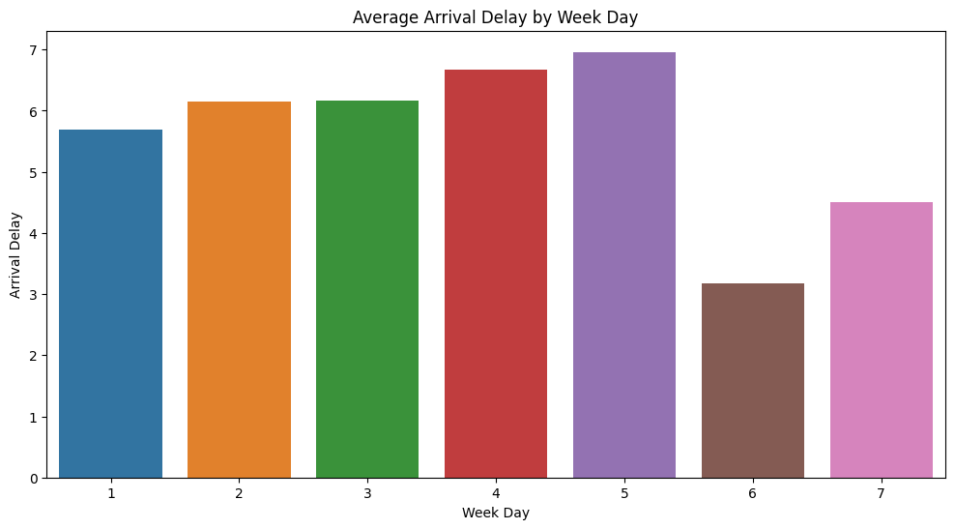

Slide 17
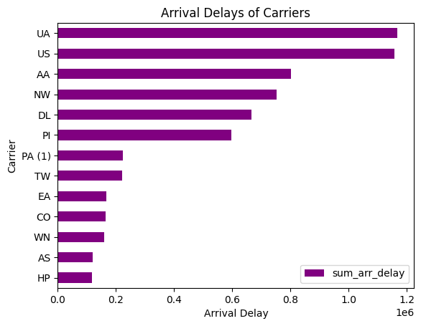

Slide 18
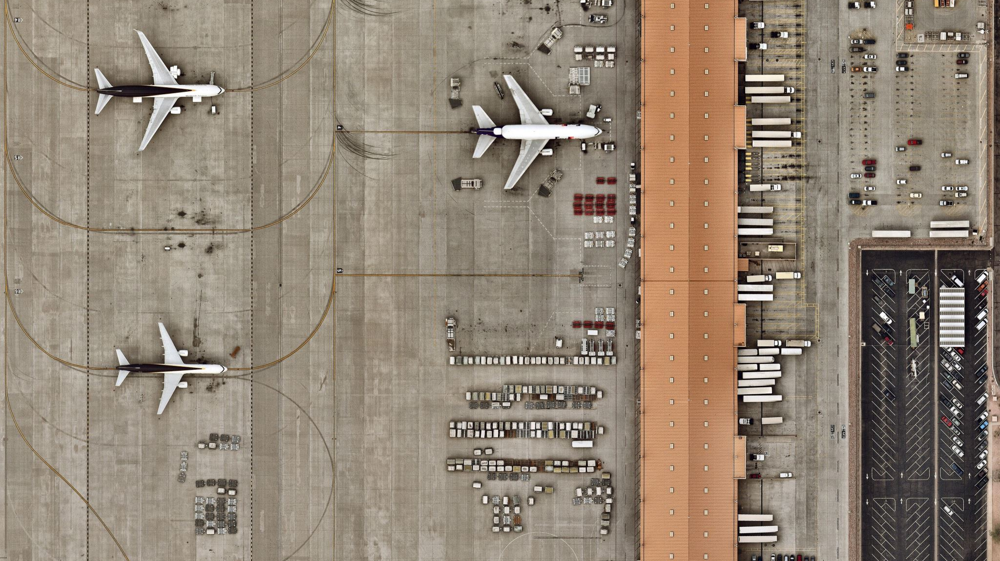
Visualizations
Find the airport with the largest number of departure flight
Find the airport with the largest number of arriving flight
Find the busiest airport
List out the top 10 airports with most departure delays in the future
List out the top 10 airports with most arrivals’ delays in the future

Slide 19
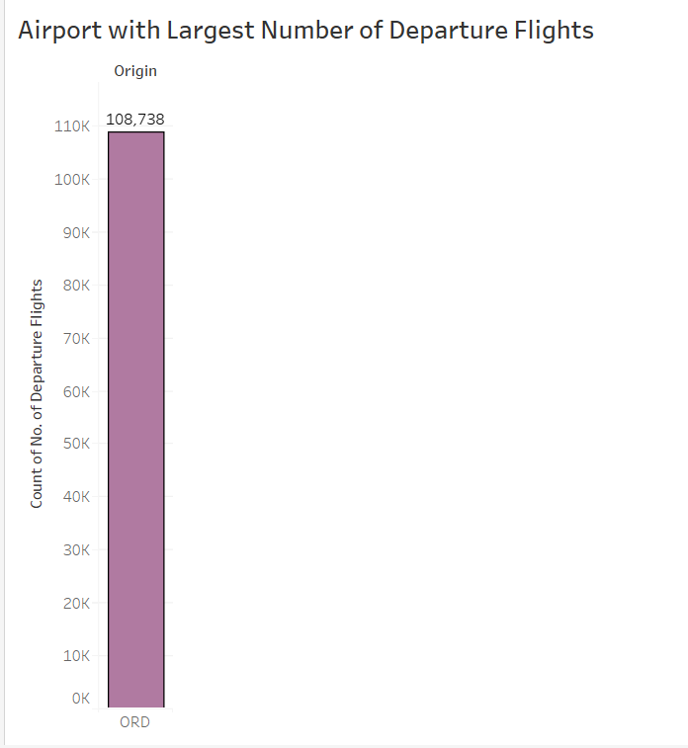
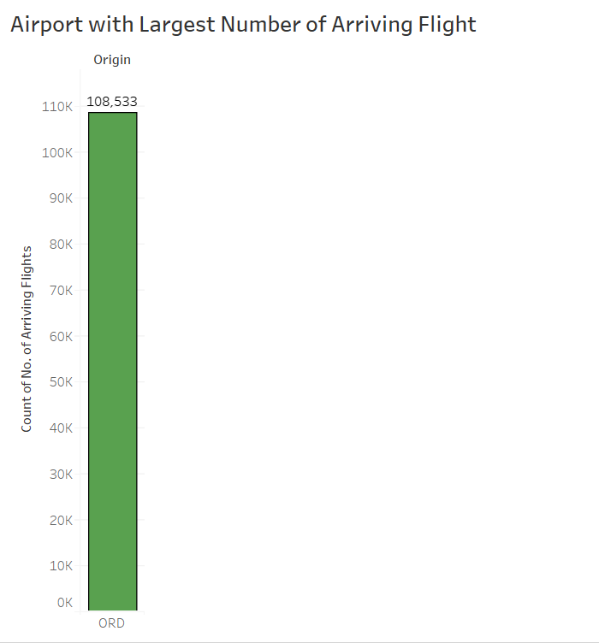
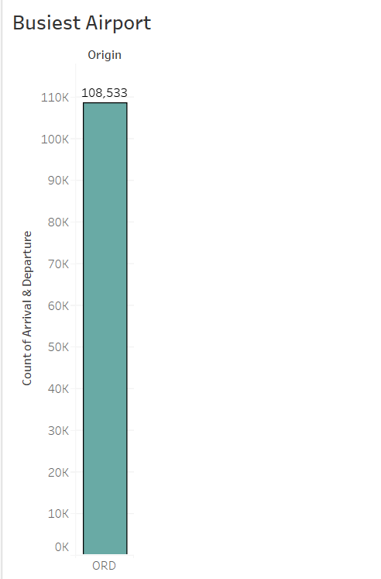
Tableau Visualizations

Slide 20
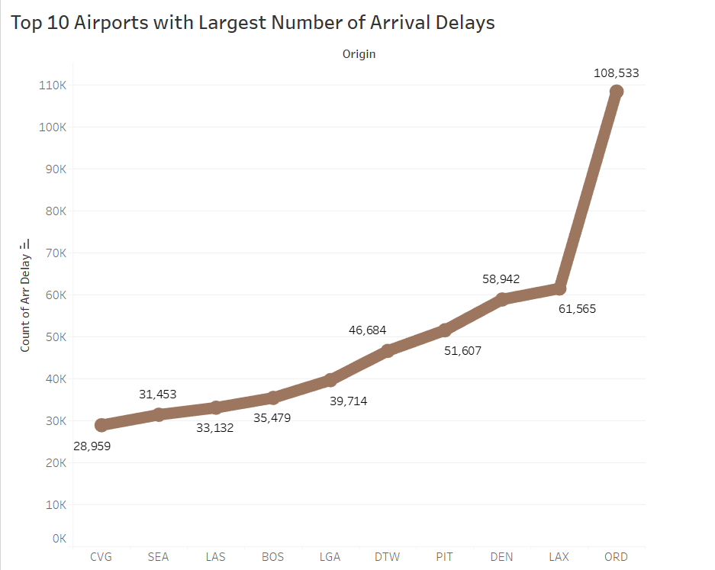
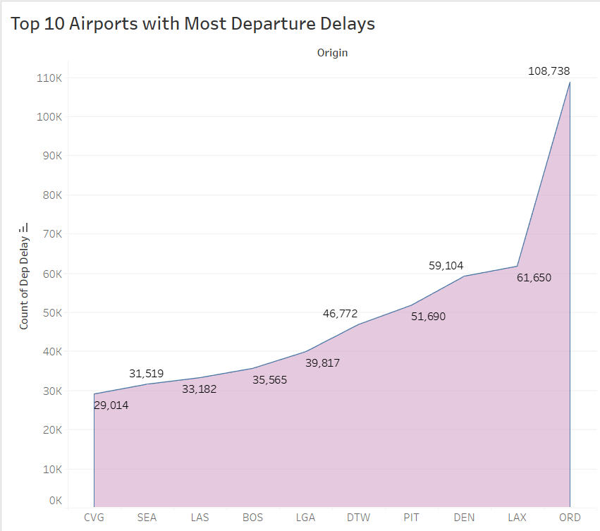
Tableau Visualizations

Slide 21
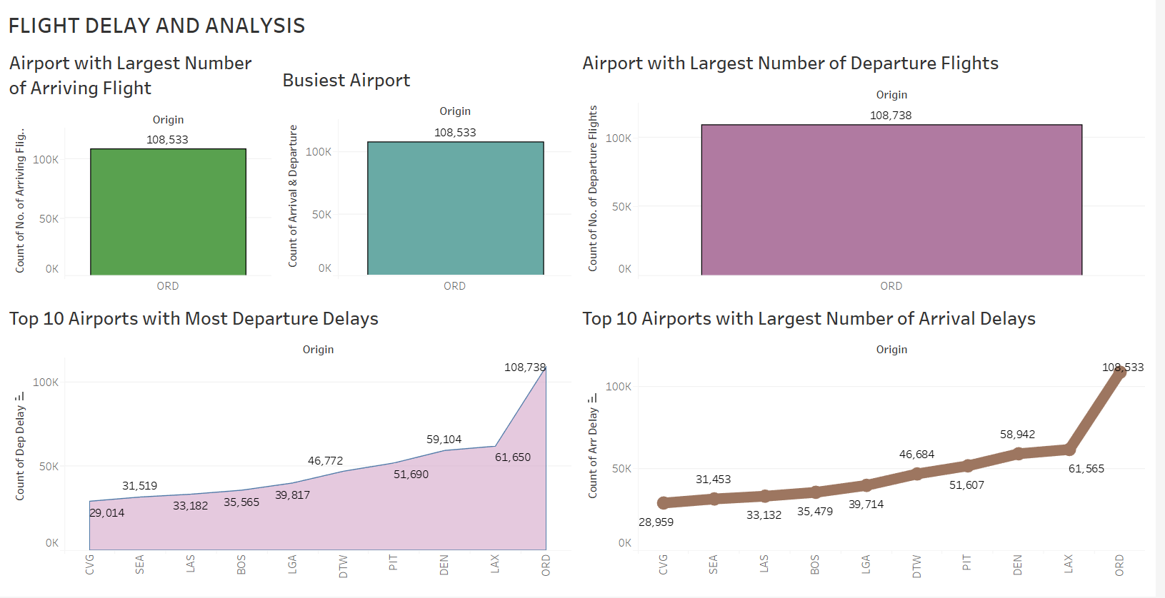
DASHBOARD

Slide 22

Findings
The busiest airport is having more departure and arrival delays.
Friday is the day of the week with the most delays, while Saturday has the least delays.
ORD airport, located in Chicago, is the busiest airport in terms of air traffic.
The carrier UA has the largest arrival delay among all the carriers in the dataset.

Slide 23

Possible Future Considerations
Implementing the whole project on a cloud platform like Data Bricks.
1
Sourcing the data from an API and integrating using Apache Kafka.
2
Leveraging the current dashboard to real-time analytical dashboard which is useful for the airport and airlines administration.
3
Building a web app using Flask for the public.
4

Slide 24


THANK YOU

Slide 25

Questions

